Slide 1
FATIMA Daily Weather Briefing
July 8
WRF forecast
Zheqi Chen

Slide 2
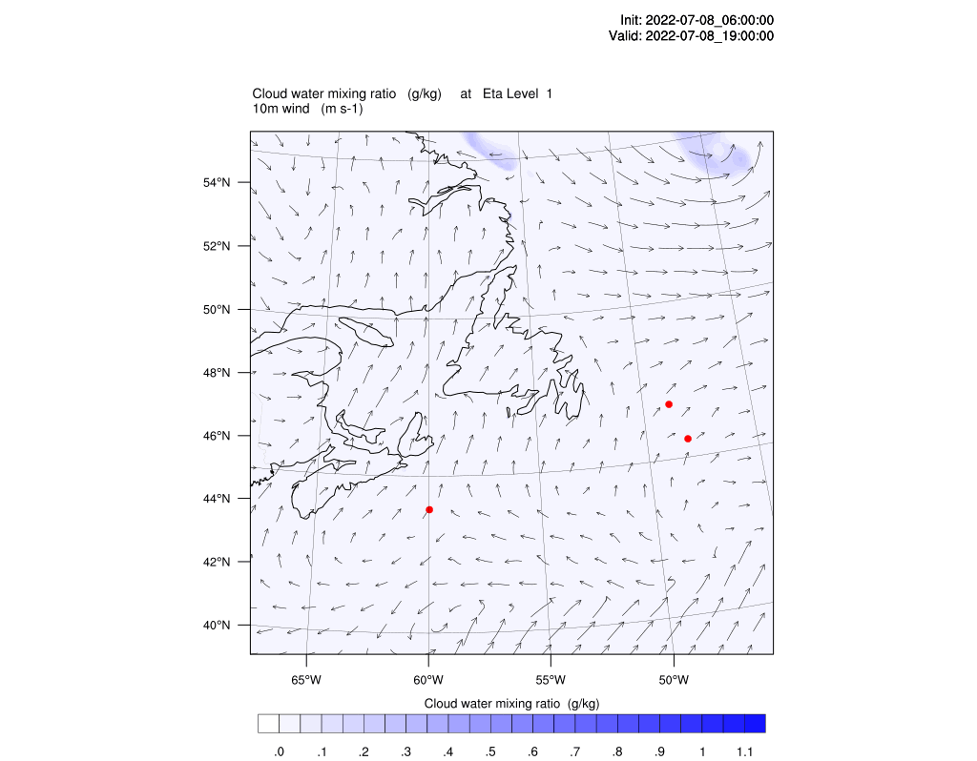
4m cloud water & 10m wind
Droplet number = 10^8/m^3 over water

Slide 3
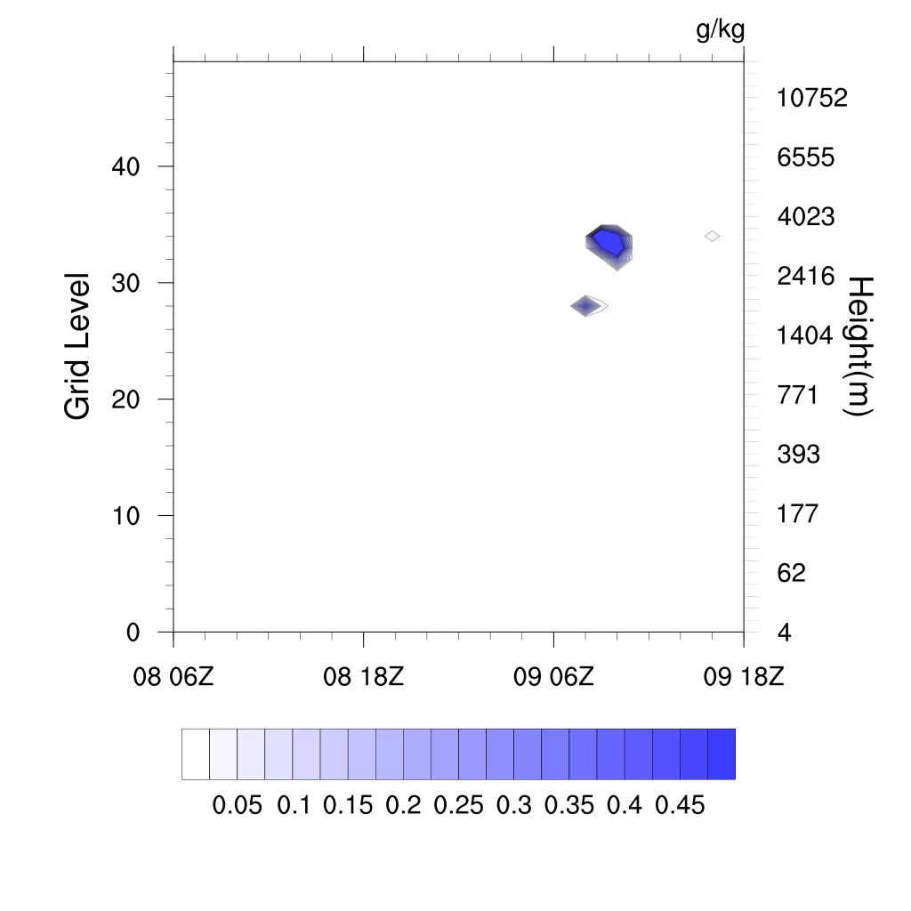
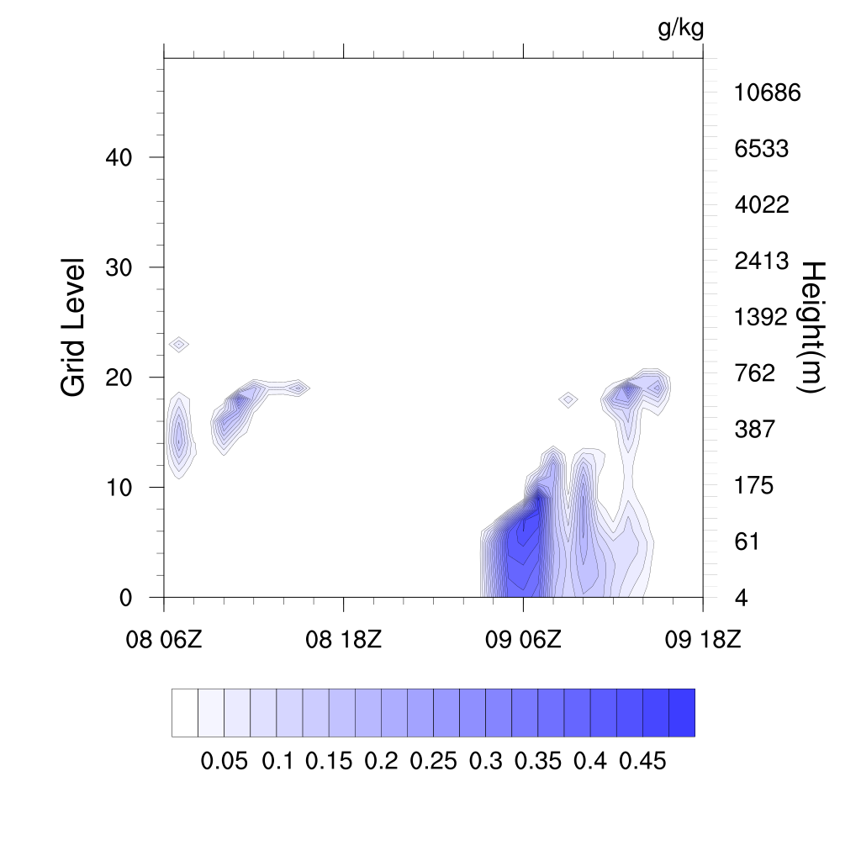
First 12 hours of the plot is spin up time
Sable Island
Hibernia oil platform

Slide 4
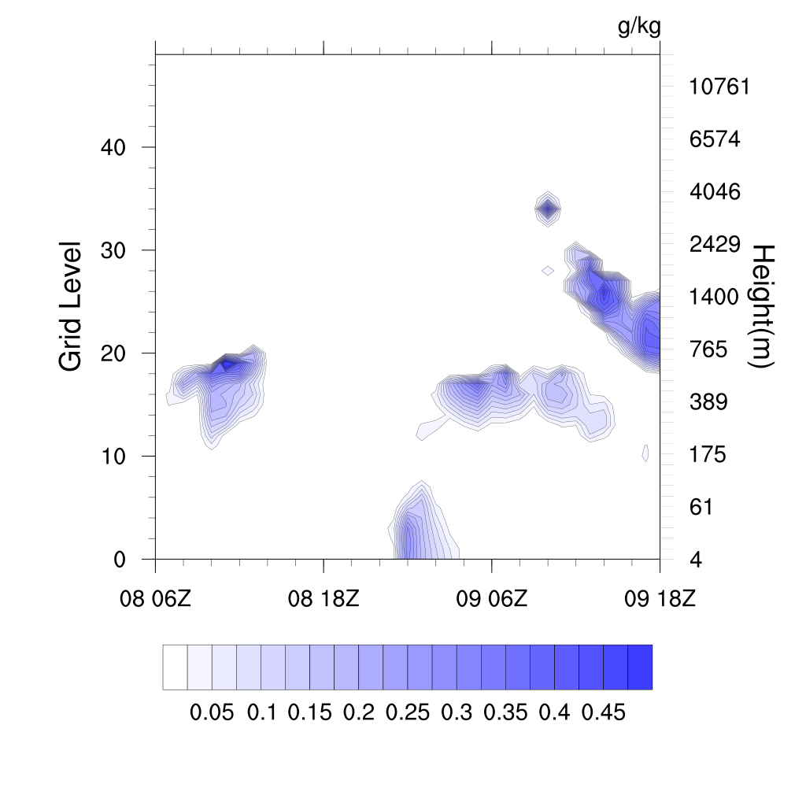
 | SI today | SI tomorrow | Ship today | Ship tomorrow | Hibernia today | Hibernia tomorrow
10m Wind speed (m/s) | 2-3 | 5-6 | 2-3 | 4-7 | 3-4 | 4
Wind direction | S | SW | S-SE | E-NE | S-SE | SE-E
Condor

